Slide 1
Bootstrap
Introduction to Bootstrap | Grid System | Bootstrap for Images | Bootstrap Components
Notes:
Welcome to our lecture on Bootstrap. In this lecture we will go through introduction to bootstrap, grid system, bootstrap for images, and bootstrap components. Let’s start our lecture.

Slide 2
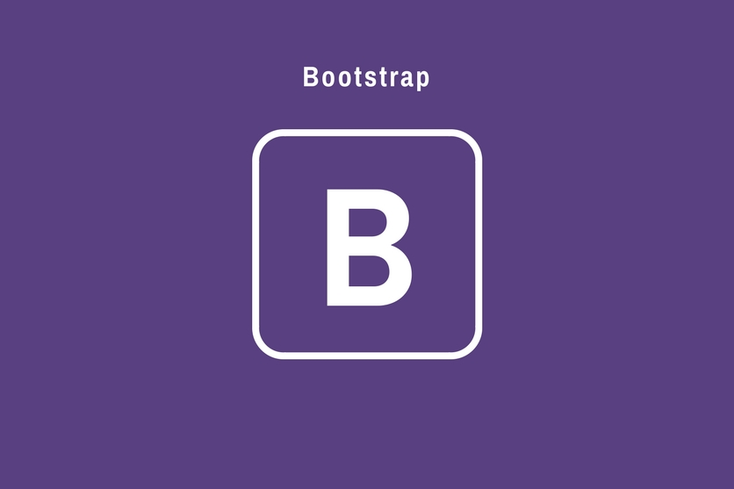
Introduction Bootstrap
Bootstrap: A popular framework for responsive websites with tools for fluid layouts and common components. Bootstrap includes:
Numerous CSS classes that aid in styling text, tables, images, etc.
A grid system for designing layouts that work on mobile, tablet, and desktop screens.
Reusable components like dropdowns, alerts, navigation, modal dialogs, etc.
Notes:
Bootstrap is a widely used framework for building responsive websites. It simplifies creating fluid layouts and offers numerous tools for web development. Bootstrap provides CSS classes for styling text, tables, and images. It includes a responsive grid system for layouts across devices and reusable components like dropdowns, alerts, and modal dialogs, making web design efficient and user-friendly.

Slide 3

Downloading Bootstrap CSS from CDN
Notes:
To use Bootstrap in your project, you can download its CSS file directly from a Content Delivery Network or CDN. This link tag imports the Bootstrap CSS into your project. Copy and paste it into the head section of your HTML file. Using a CDN ensures fast loading times and always provides the latest version of Bootstrap without downloading files locally.

Slide 4
Bootstrap Grid
Bootstrap Grid: A 12-column responsive system that adjusts layouts for various screen sizes. The grid system is applied to a block element using one of two classes:
container - Creates a responsive fixed-width container with a max-width that changes at various breakpoints.
container-fluid - Creates a responsive container with a 100% width.
Notes:
The Bootstrap grid system uses a 12-column layout that adjusts for different screen sizes. It provides two main container classes. The container class creates a fixed-width responsive container that adjusts at breakpoints. The container-fluid class creates a full-width responsive container that spans 100 percent of the viewport. These classes ensure your design adapts seamlessly across devices.

Slide 5
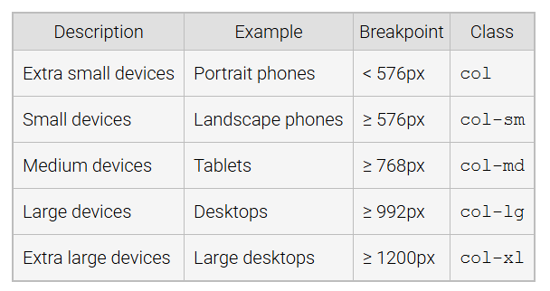
Bootstrap Break Points
Notes:
Bootstrap breakpoints define screen sizes for responsive design. These include extra small for portrait phones under 576px, small for landscape phones at 576px, medium for tablets at 768px, large for desktops at 992px, and extra large for large desktops at 1200px. Classes like col-sm and col-md apply the grid system at specific breakpoints to create adaptive layouts for all devices.

Slide 6
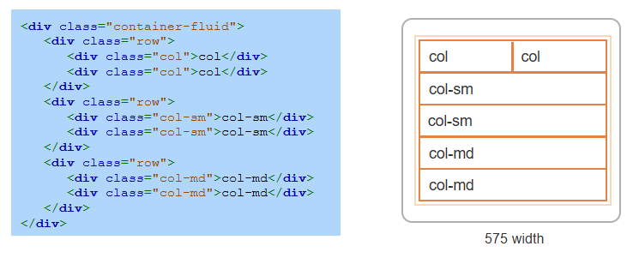
Bootstrap Grid Example
Notes:
This example demonstrates the Bootstrap grid system using a container-fluid and rows. Each row contains columns defined with classes like col, col-sm, and col-md. The col class spans available space, while col-sm and col-md adjust based on screen size. For instance, col-sm applies to small devices above 576px. This layout ensures responsiveness, adapting smoothly across different screen widths.

Slide 7
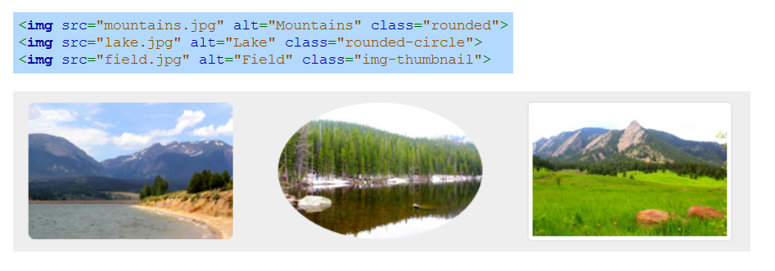
Bootstrap for Images
Bootstrap provides three CSS classes to place images into shapes: rounded, rounded-circle, and img-thumbnail.
Notes:
Bootstrap makes styling images easy with CSS classes. The rounded class gives images rounded corners, rounded-circle creates circular images, and img-thumbnail adds a border and padding for a thumbnail effect. These classes can be applied to the img tag, as shown in the code. They allow developers to quickly enhance image presentation in responsive and visually appealing designs.

Slide 8
Bootstrap Components
Bootstrap provides many components for developing interactive user interfaces. Ex:
Button to display a custom button.
Carousel to cycle through images or text in a slideshow.
Dropdown to display a dropdown menu.
Progress to display a progress bar.
Notes:
Bootstrap offers various components to build interactive user interfaces. Examples include buttons for custom actions, carousels to cycle through images or text, dropdowns for menus, and progress bars to display task progress. These components are pre-designed and easy to integrate, helping developers create functional and visually appealing interfaces quickly. Thanks for watching the lecture.

